Slide 1
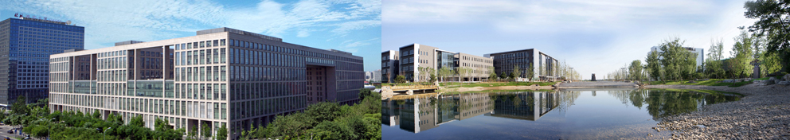
Design and Analysis of Algorithms
Lecture 1: Introduction
Ke Xu and Yongxin Tong
(许可 与 童咏昕)
School of CSE, Beihang University

Slide 2
Outline
About Us
Course Details
A.M. Turing Award Winners for Algorithms
What Is This Course About
What Are Algorithms
What Does It Mean to Analyze An Algorithm
Comparing Time Complexity

Slide 3
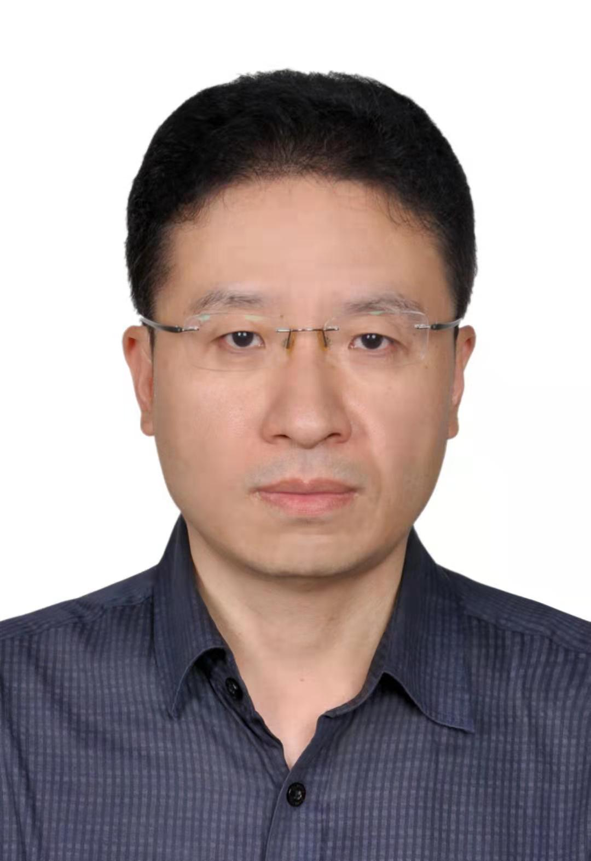

Instructors
Ke Xu
Professor
State Key Lab. of Software Development Environment
Research Interests: Algorithms, Phase Transitions in NPC, Logic and Complexity, Data Mining
Yongxin Tong
Researcher
State Key Lab. of Software Development Environment
Research Interests: Big Data, Crowd Intelligence, Data Mining, Federated/Reinforcement Learning
Notes:
迪杰特斯拉和快排

Slide 4
Contact and TAs
Contact
Ke Xu
Office: Room G1131, New Main Building
Email: kexu@nlsde.buaa.edu.cn
Homepage: http://sites.nlsde.buaa.edu.cn/~kexu/
Yongxin Tong
Office: Room 1811, Baiyan Building
Email: yxtong@buaa.edu.cn
Homepage: http://sites.nlsde.buaa.edu.cn/~yxtong/
TAs
Yexuan Shi (Ph.D. Student)
Email: skyxuan@buaa.edu.cn
Pengfei Zheng (Master Student)
Email: zpflyfe@163.com
Lipeng Zhang (Master Student)
Email: panoszhang@outlook.com

Slide 5
Instructors: Yongxin Tong
Beihang University (2015.4 - Current)
“Zhuoyue Program” Distinguished Researcher
State Key Lab. of Software Development Environment
Research Interests: Big Data and Crowd Intelligence
HKUST (2010.8 – 2015.3)
Research Assistant Professor (2014.2 – 2015.3)
CSE Department, focused on big data and crowdsourcing
Ph.D. Student and Candidate (2010.8 – 2014.1)
CSE Department, focused on data mining and crowdsourcing

Slide 6
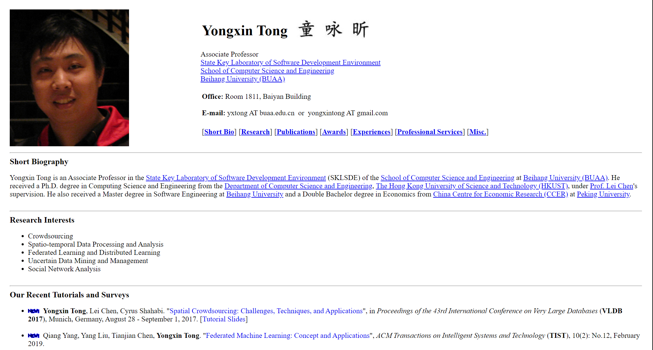
Instructors: Yongxin Tong

Slide 7
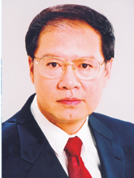
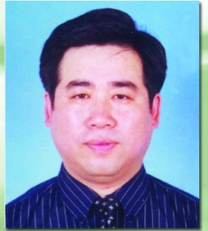


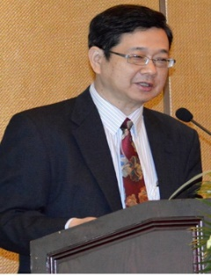
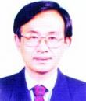

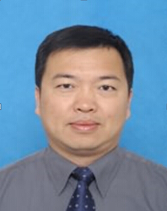
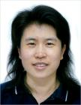
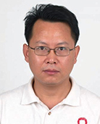
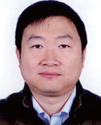
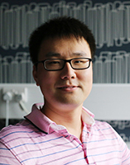



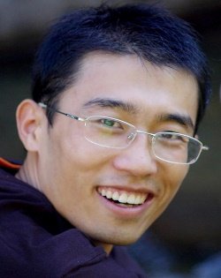
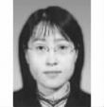
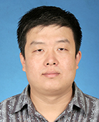

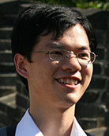
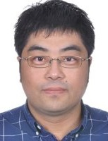
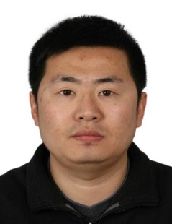

Faculty Members in SKLSDE
李未教授
马殿富教授
吕卫锋教授
尹宝林教授
蔡维德教授
马世龙教授
张玉平教授
许可教授
张辉教授
郎波教授
杨钦教授
吴文峻教授
朱皞罡教授
诸彤宇副教授
丁嵘副教授
童咏昕副教授
刘瑞副教授
刘祥龙副教授
吕江花博士
孟宪海博士
李吉刚博士
罗杰博士
杜博文博士
王德庆博士

Slide 8
Outline
About Us
Course Details
A.M. Turing Award Winners for Algorithms
What Is This Course About
What Are Algorithms
What Does It Mean to Analyze An Algorithm
Comparing Time Complexity

Slide 9
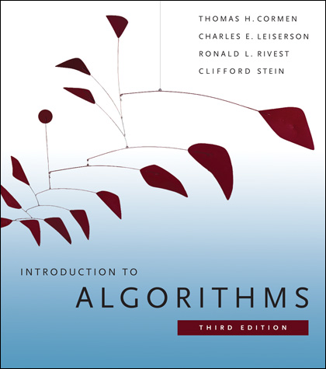
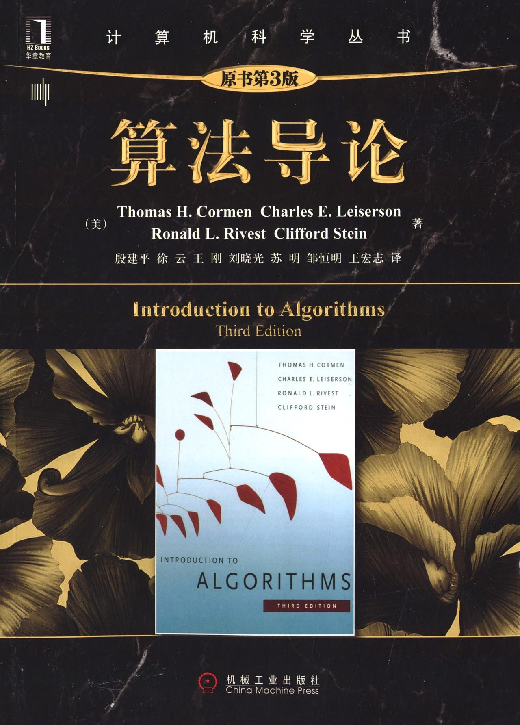
Textbook
Textbook: Introduction to Algorithms (3rd ed.)
by Cormen, Leiserson, Rivest and Stein (CLRS)
Prepublication version available online

Slide 10
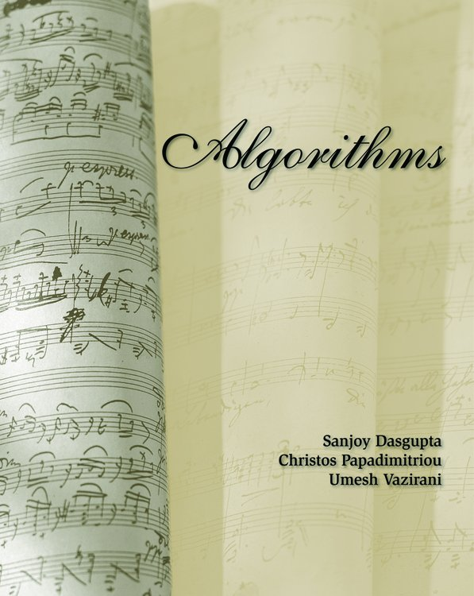
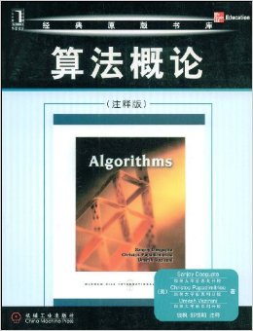
References (1)
Reference: Algorithms
by Dasgupta, Papadimitriou, and Vazirani (DPV)
Prepublication version available online

Slide 11
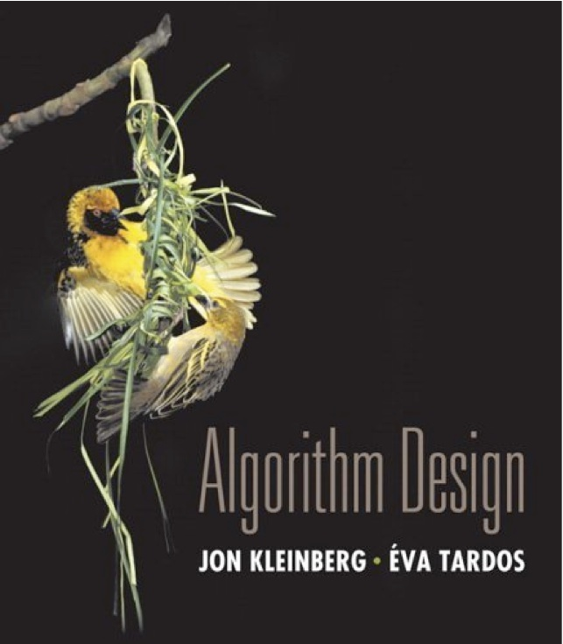
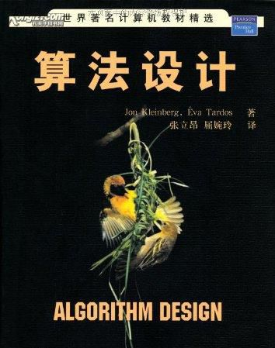
References (2)
Reference: Algorithm Design
by Kleinberg and Tardos (KT)

Slide 12
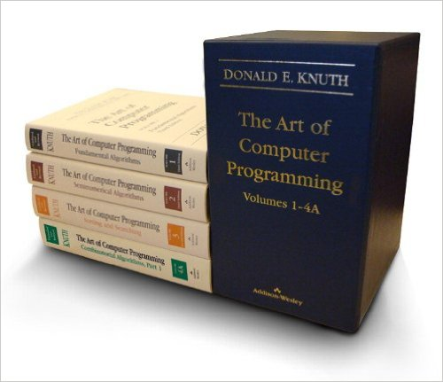
References (3)
Reference: The Art of Computer Programming
by Donald E. Knuth

Slide 13
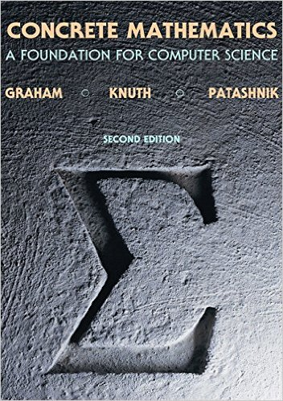
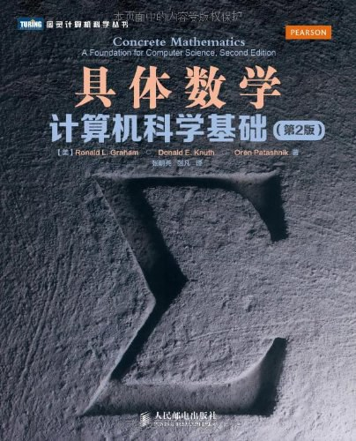
References (4)
Reference: Concrete Mathematics (2nd ed.)
by Graham, Knuth, Patashnik (GKP)

Slide 14
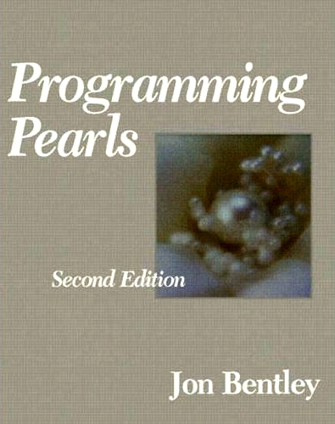

References (5)
Reference: Programming Pearls (2nd ed.)
by Jon Bentley

Slide 15
Prerequisites
We assume you know:
Linked Lists, Stacks, Queues
Binary Search Trees
Traversals
Searching (but not analysis)
What have you learnt previously?
Graph algorithms
Breadth-first search (BFS)
Depth-first search (DFS)
Topological sort (TS)
Minimum Spanning Trees (MST)
Dijkstra's shortest path algorithm (SP)

Slide 16
Tentative Syllabus
Basics
Asymptotic Notations and Recurrences
Divide and Conquer Algorithms
MCS Problem, PM Problem, and Quicksort
Dynamic Programming Algorithms
0-1 Knapsack, Rod-Cutting, CMM, LCS, and MDE
Greedy Algorithms
Huffman Coding and Fractional Knapsack
Graph Algorithms
BFS, DFS, SP, MST, Max Flow and Matching
Dealing with Hard Problems
Problem Classes (P, NP, NPC) and Approximation Alg.

Slide 17
Lectures and Tutorials
Lectures
Slides will be available on course web page.
Tutorials (补充练习)
There will be 12 tutorials in this semester.
The tutorials will provide more examples to illustrate the material you learnt in class.
The first tutorial will be released on next week.

Slide 18
Grading Scheme
(30%) Four Assignments
Each requires designing algorithms and analyzing correctness/running time.
Each takes 14 days. The first one will be released on Sep. 27.
After each submission due, we will post the solution and WON’T accept any assignment.
Failing to do any of these will be considered plagiarism, and may result in a failing grade in the course.
(10%) Project
Each project is completed by a group.
Each group needs to submit a final report and codes.
The topics of the project will be released by the end of Sep.
(60%) Final Exam
It covers the materials of the entire semester.

Slide 19
Classroom Etiquette
No roll-call in our class !
Turn off cell phone ringers.
No phone conversations in room.
Latecomers should enter quietly.
No LOUD talking among selves during lectures.

Slide 20

WeChat Group

Slide 21
Outline
About Us
Course Details
A.M. Turing Award Winners for Algorithms
What Is This Course About
What Are Algorithms
What Does It Mean to Analyze An Algorithm
Comparing Time Complexity

Slide 22
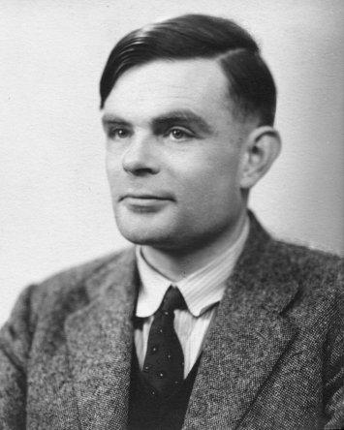

A.M. Turing Award
From 2007 to 2013, the award was accompanied by a prize of US $250,000 by Intel and Google. Since 2014, the award has been accompanied by a prize of US $1 million by Google.
Alan M. Turing
Nobel Prize of Computing
Since 1966，there have been 70 recipients of A.M. Turing Award!
This year is the 53rd anniversary of A.M. Turing Award!

Slide 23
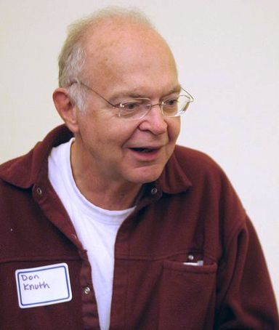
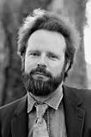
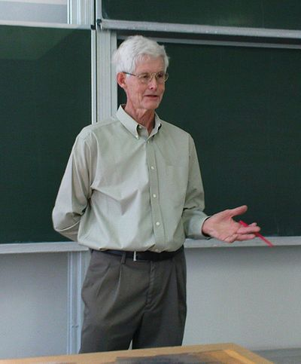
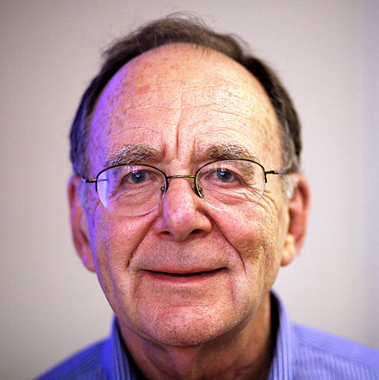

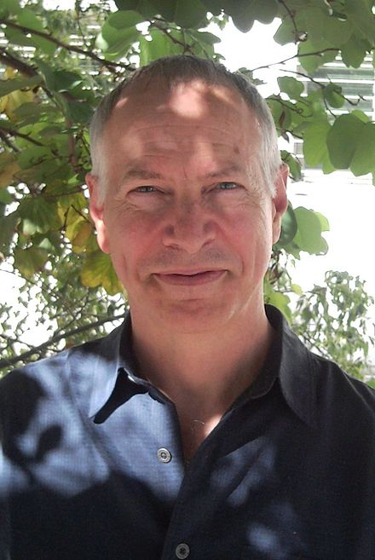
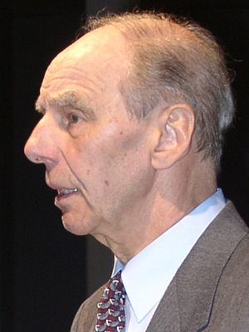
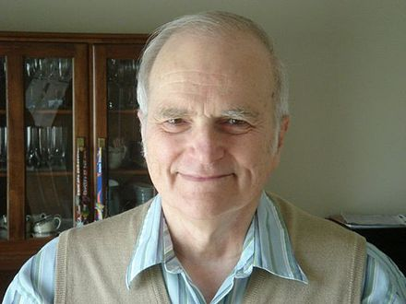
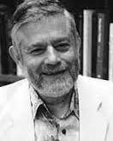
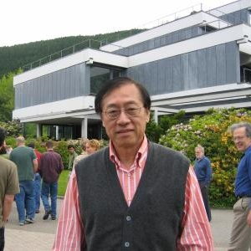
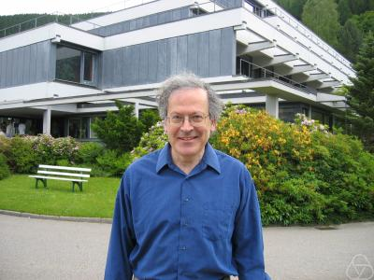
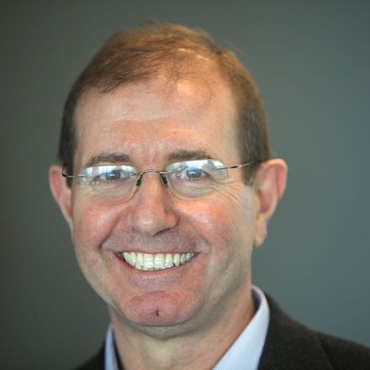
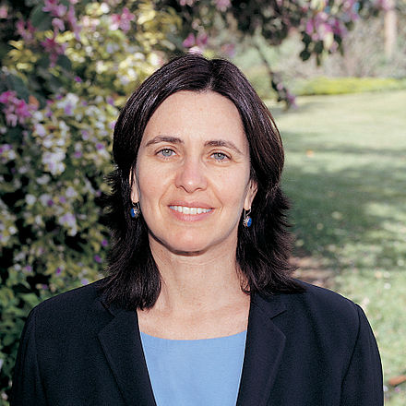
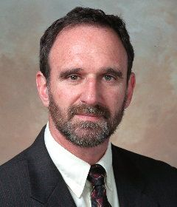
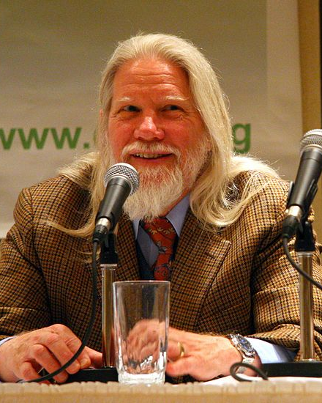
A.M. Turing Award Winners for Algorithms
Donald E. Knuth 1974, USA
Robert W. Floyd
1978, USA
Stephen A. Cook
1982, USA
Richard M. Karp
1985, USA
John Hopcroft
1986, USA
Robert Tarjan
1986, USA
Juris Hartmanis
1993, Latvia
Richard E. Stearns
1993, USA
Manuel Blum
1995, Venezuela
Andrew Yao
2000, China
Leslie G. Valiant
2010, Hungarian
Silvio Micali
2012, Italy
Shafi Goldwasser
2012, USA
Martin Hellman
2015, USA
Whitfield Diffie
2015, USA
Notes:
增加2015两位密码学领域得主

Slide 24

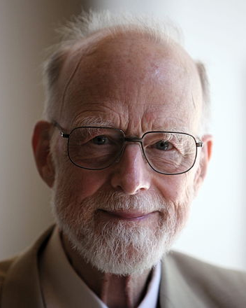
Other Related A.M. Turing Award Winners
Edsger W. Dijkstra
The Recipient in 1972, Netherlands,
Contributions: ALGOL Father,
Related Work: Dijkstra Algorithm
Tony Hoare
The Recipient in 1980,
UK,
Contributions: Hoare logic,
Related Work: QuickSort
Notes:
迪杰特斯拉和快排

Slide 25


Books of A.M. Turing Award Winners

Slide 26
Outline
About Us
Course Details
A.M. Turing Award Winners for Algorithms
What Is This Course About
What Are Algorithms
What Does It Mean to Analyze An Algorithm
Comparing Time Complexity

Slide 27
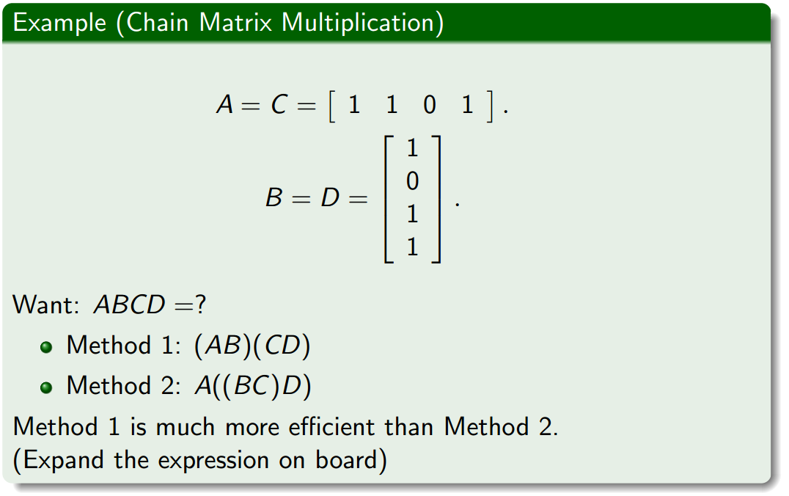
What is this course about?

Slide 28
What is this course about?
There is usually more than one algorithm for solving a problem.
Some algorithms are more efficient than others.
We want the most efficient algorithm.

Slide 29
What is this course about?
If we have a number of alternative algorithms for solving a problem, how do we know which is the most efficient?
To do so, we need to analyze each of them to determine its efficiency.
Of course, we must also make sure the algorithm is correct.

Slide 30
What is this course about?
In this course, we will discuss fundamental techniques for:
Designing efficient algorithms,
Proving the correctness of algorithms,
Analyzing the running times of algorithms

Slide 31
What is this course about?
In this course, we will discuss fundamental techniques for:
Designing efficient algorithms,
Proving the correctness of algorithms,
Analyzing the running times of algorithms
Note:
Analysis and design go hand-in-hand: By analyzing the running times of algorithms, we will know how to design fast algorithms

Slide 32
Outline
About Us
Course Details
A.M. Turing Award Winners for Algorithms
What Is This Course About
What Are Algorithms
What Does It Mean to Analyze An Algorithm
Comparing Time Complexity

Slide 33
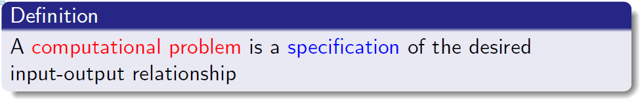
Computational Problem

Slide 34
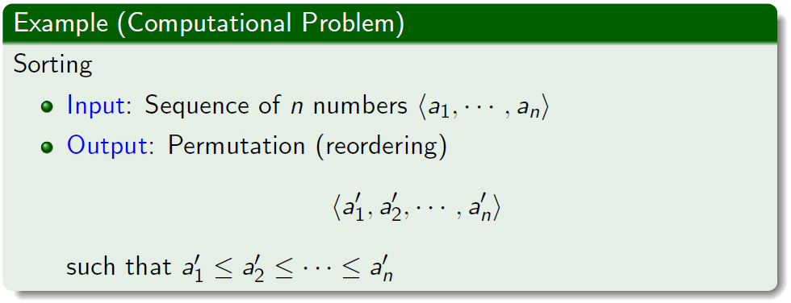
Computational Problem

Slide 35
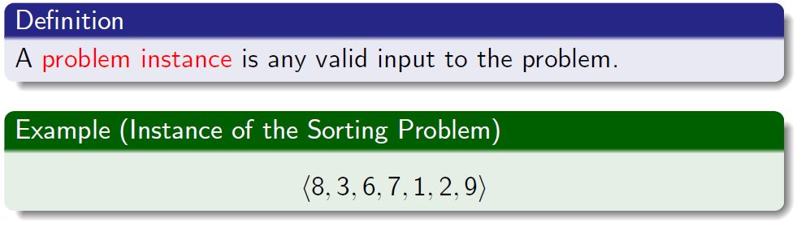
Instance

Slide 36
Instance

Slide 37
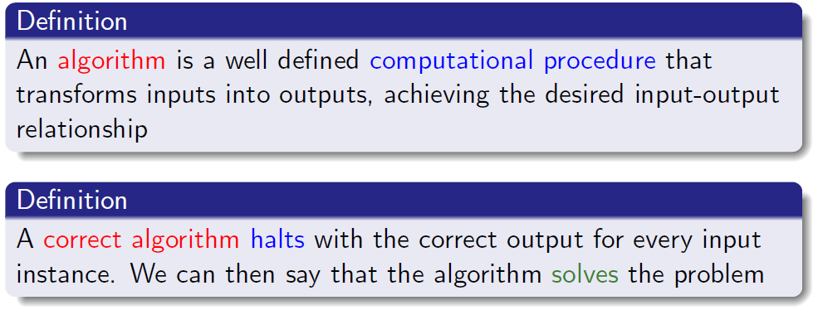
Algorithm

Slide 38
Algorithm

Slide 39
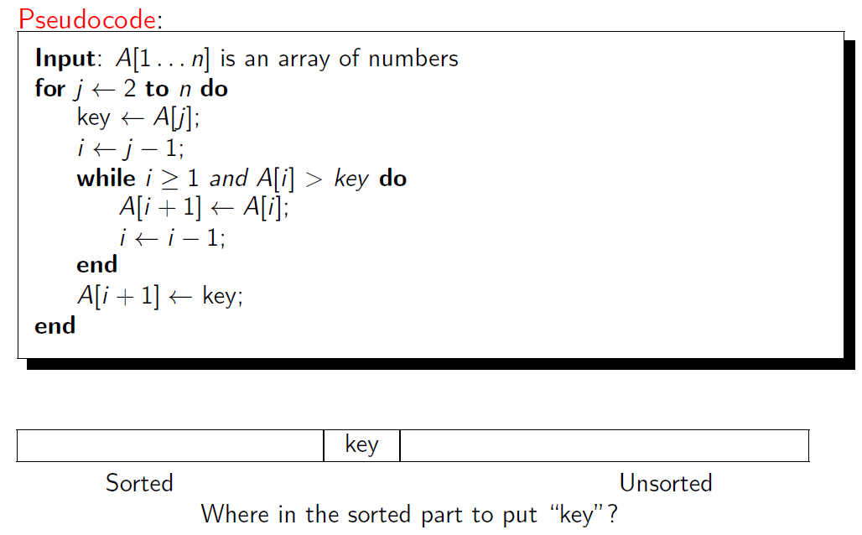
Example: Insertion Sort

Slide 40

How Does It Work?
An incremental approach: To sort a given array of length n, at the ith step it sorts the array of the first i items by making use of the sorted array of the first i - 1 items

Slide 41
Outline
About Us
Course Details
A.M. Turing Award Winners for Algorithms
What Is This Course About
What Are Algorithms
What Does It Mean to Analyze An Algorithm
Comparing Time Complexity

Slide 42
Analyzing Algorithms
Predict resource utilization
Memory (space complexity)
Running time (time complexity) -- focus of this course

Slide 43
Analyzing Algorithms
Predict resource utilization
Memory (space complexity)
Running time (time complexity) -- focus of this course
depends on the speed of the computer

Slide 44
Analyzing Algorithms
Predict resource utilization
Memory (space complexity)
Running time (time complexity) -- focus of this course
depends on the speed of the computer
depends on the implementation details

Slide 45
Analyzing Algorithms
Predict resource utilization
Memory (space complexity)
Running time (time complexity) -- focus of this course
depends on the speed of the computer
depends on the implementation details
depends on the input, especially on the size of the input

Slide 46
Analyzing Algorithms
Predict resource utilization
Memory (space complexity)
Running time (time complexity) -- focus of this course
depends on the speed of the computer
depends on the implementation details
depends on the input, especially on the size of the input
In light of the above factors, how can we compare different algorithms in terms of their running times?

Slide 47
Analyzing Algorithms
Predict resource utilization
Memory (space complexity)
Running time (time complexity) -- focus of this course
depends on the speed of the computer
depends on the implementation details
depends on the input, especially on the size of the input
In light of the above factors, how can we compare different algorithms in terms of their running times?
We want to find a way of measuring running times that is mathematically elegant and machine-independent.

Slide 48
Machine-independent running time
We will measure the running time as the number of primitive operations (e.g., addition, multiplication, comparisons) used by the algorithm

Slide 49
Machine-independent running time
We will measure the running time as the number of primitive operations (e.g., addition, multiplication, comparisons) used by the algorithm
We will measure the running time as a function of the input size. Let n denote the input size and let T(n) denote the running time for input of size n.

Slide 50
Machine-independent running time
We will measure the running time as the number of primitive operations (e.g., addition, multiplication, comparisons) used by the algorithm
We will measure the running time as a function of the input size. Let n denote the input size and let T(n) denote the running time for input of size n.
Input size n: rigorous definition given later
Sorting: number of items to be sorted

Slide 51
Machine-independent running time
We will measure the running time as the number of primitive operations (e.g., addition, multiplication, comparisons) used by the algorithm
We will measure the running time as a function of the input size. Let n denote the input size and let T(n) denote the running time for input of size n.
Input size n: rigorous definition given later
Sorting: number of items to be sorted
Graphs: number of vertices and edges

Slide 52

Three Kinds of Analysis: I

Slide 53
Three Kinds of Analysis: I

Slide 54
Three Kinds of Analysis: I

Slide 55

Three Kinds of Analysis: II

Slide 56
Three Kinds of Analysis: II

Slide 57
Three Kinds of Analysis: II

Slide 58

Three Kinds of Analysis: III

Slide 59
Three Kinds of Analysis: III

Slide 60
Three Kinds of Analysis: III

Slide 61
Three Kinds of Analysis
Best case: Clearly useless

Slide 62
Three Kinds of Analysis
Best case: Clearly useless
Worst case: Commonly used, will also be used in this course
Gives a running time guarantee no matter what the input is
Fair comparison among different algorithms

Slide 63
Three Kinds of Analysis
Best case: Clearly useless
Worst case: Commonly used, will also be used in this course
Gives a running time guarantee no matter what the input is
Fair comparison among different algorithms
Average case: Used sometimes
Need to assume some distribution: real-world inputs are seldom uniformly random!
Analysis is complicated

Slide 64
Three Kinds of Analysis
Best case: Clearly useless
Worst case: Commonly used, will also be used in this course
Gives a running time guarantee no matter what the input is
Fair comparison among different algorithms
Average case: Used sometimes
Need to assume some distribution: real-world inputs are seldom uniformly random!
Analysis is complicated
Will not be used in this course

Slide 65
Outline
About Us
Course Details
A.M. Turing Award Winners for Algorithms
What Is This Course About
What Are Algorithms
What Does It Mean to Analyze An Algorithm
Comparing Time Complexity

Slide 66

Comparing Time Complexity
Which algorithm is superior for large n?
T(n) for Algorithm 1 is 3n³ + 6n² - 4n + 17
T(n) for Algorithm 2 is 7n² - 8n + 20
Clearly, Algorithm 2 is superior.

Slide 67
Asymptotic Analysis
T(n) for Algorithm 1 is 3n³ + 6n² - 4n + 17 = Θ(n³)

Slide 68
Asymptotic Analysis
T(n) for Algorithm 1 is 3n³ + 6n² - 4n + 17 = Θ(n³)
T(n) for Algorithm 2 is 7n² - 8n + 20 = Θ(n²)

Slide 69
Asymptotic Analysis
T(n) for Algorithm 1 is 3n³ + 6n² - 4n + 17 = Θ(n³)
T(n) for Algorithm 2 is 7n² - 8n + 20 = Θ(n²)
Θ-notation
Drop low-order terms; ingore leading constants

Slide 70
Asymptotic Analysis
T(n) for Algorithm 1 is 3n³ + 6n² - 4n + 17 = Θ(n³)
T(n) for Algorithm 2 is 7n² - 8n + 20 = Θ(n²)
Θ-notation
Drop low-order terms; ingore leading constants
Look at growth of T(n) as n→∞

Slide 71
Asymptotic Analysis
T(n) for Algorithm 1 is 3n³ + 6n² - 4n + 17 = Θ(n³)
T(n) for Algorithm 2 is 7n² - 8n + 20 = Θ(n²)
Θ-notation
Drop low-order terms; ignore leading constants
Look at growth of T(n) as n→∞
When n is large enough, a Θ(n²) algorithm always beats a Θ(n³) algorithm

Slide 72

Merge Sort

Slide 73
Merge Sort

Slide 74
Merge two sorted arrays
3
6
9
16
2
5
8
12

Slide 75
Merge two sorted arrays
2
3
6
9
16
5
8
12

Slide 76
Merge two sorted arrays
2
3
6
9
16
5
8
12

Slide 77
Merge two sorted arrays
2
3
5
6
9
16
8
12

Slide 78
Merge two sorted arrays
2
3
5
6
9
16
8
12

Slide 79
Merge two sorted arrays
2
3
5
6
8
9
16
12

Slide 80
Merge two sorted arrays
2
3
5
6
8
9
16
12

Slide 81
Merge two sorted arrays
2
3
5
6
8
9
12
16

Slide 82
Merge two sorted arrays
2
3
5
6
8
9
12
16

Slide 83

Three Kinds of Analysis
T(n): time needed to run Mergesort(A,1,n)
Assume n is a power of 2 for simplicity

Slide 84
Three Kinds of Analysis
T(n): time needed to run Mergesort(A,1,n)
Assume n is a power of 2 for simplicity

Slide 85
Three Kinds of Analysis
T(n): time needed to run Mergesort(A,1,n)
Assume n is a power of 2 for simplicity

Slide 86
Three Kinds of Analysis
T(n): time needed to run Mergesort(A,1,n)
Assume n is a power of 2 for simplicity

Slide 87

Three Kinds of Analysis

Slide 88

Three Kinds of Analysis

Slide 89

Three Kinds of Analysis

Slide 90

Three Kinds of Analysis

Slide 91

Three Kinds of Analysis

Slide 92

Three Kinds of Analysis

Slide 93


